Slide 1


science
SWACHH BHARAT ABHIYAN

Slide 2

REPRESENTED BY
01
02
03
PRASHANT 2306112
SAMEER
2306120
TANAY
230125
04
05
SHUBHAM
2306154
DEEPAK
2306155

Slide 3

01
INTRODUCTION

Slide 4
TIMELINE (2014-2023)
Awareness
Swacchta Hi Sewa
Swacch Bharat 2.0
Beginning
2 Oct 2014
2014-2019
2 Oct 2019
15 Sept - 2 Oct 2023
Launching of Swacch Bharat Mission.
Awareness In People about Sanitization and Hygiene.
The government declared rural India open-defecation-free (ODF)
Ongoing Swachhata-Jal Mission,efforts continue towards Clean India.

Slide 5

Beginning of Swachh Bharat
2 Oct 2014
Prime Minister Narendra Modi officially launched the Swachh Bharat Abhiyan on Mahatma Gandhi's birth anniversary. The mission aimed to achieve a clean India by October 2, 2019, the 150th birth anniversary of Mahatma Gandhi

Slide 6
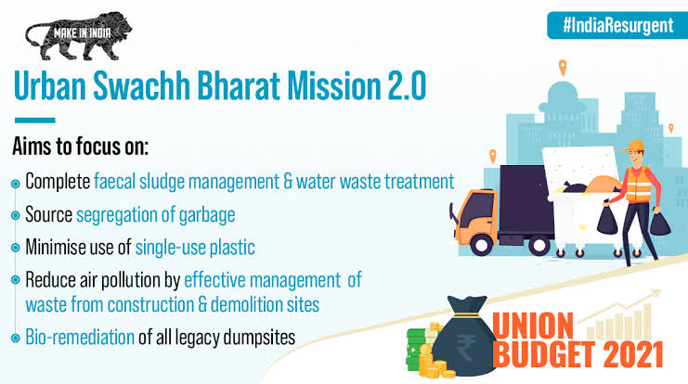
Swachh Bharat 2.0
2 Oct 2019
The government declared rural India open-defecation-free (ODF) on the 150th birth anniversary of Mahatma Gandhi. The Swachh Bharat Abhiyan was extended beyond its original deadline. The government announced Swachh Bharat 2.0 with a renewed focus on solid waste management, sustainability, and cleanliness in public places.

Slide 7

Awareness program
2014-2019
The initial phase of the mission focused on building awareness about sanitation and hygiene, constructing toilets, and promoting cleanliness. The government collaborated with various state governments, NGOs, and private organizations to implement the program.

Slide 8
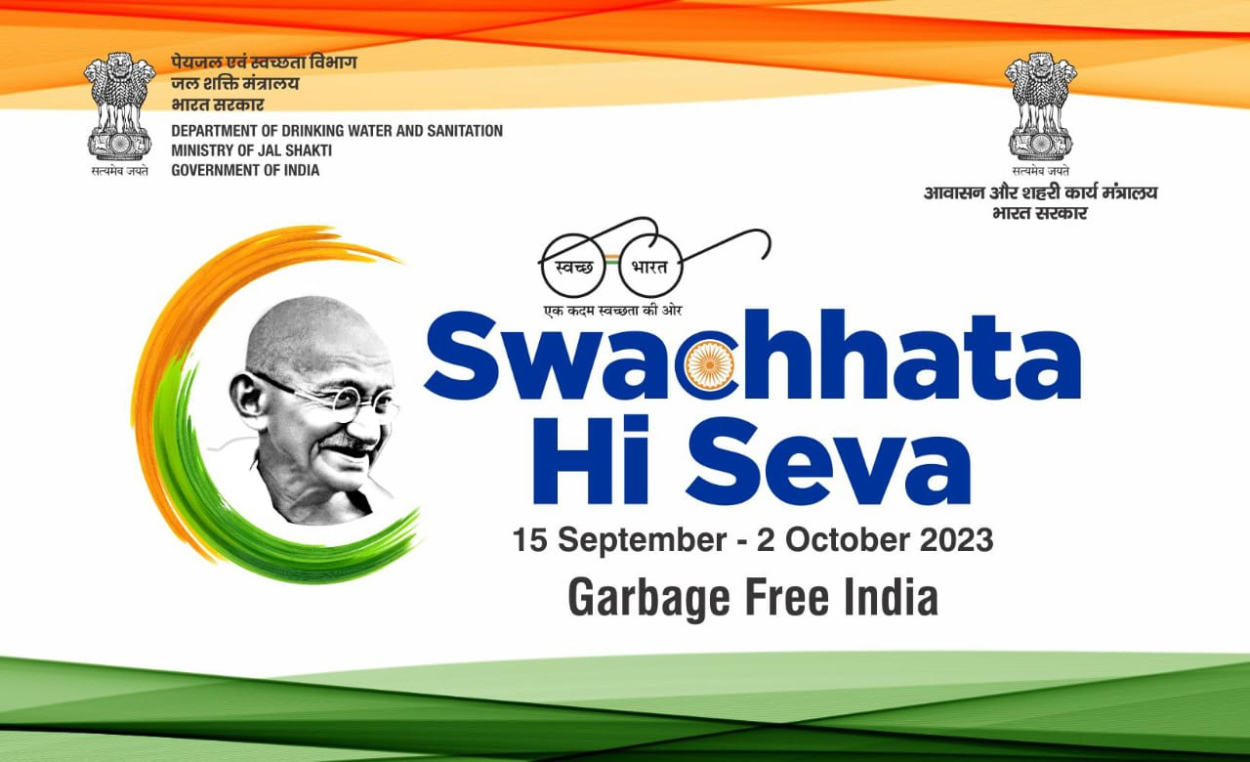
Swachhta Hi Sewa
15 Sept-2 Oct 2023
Swachh Bharat Mission – Urban and Grameen shall jointly organize the campaign from 15th September 2023 to 2nd October 2023. As a prelude to Swachh Bharat Diwas, the campaign of Swchhata Hi Seva 2023 is being organized. The thought behind the campaign is to mobilize the participation of crores of citizens across the country through activities such as Indian Swachhata League 2.0, SafaiMitra Suraksha Shivir, and cleanliness drives. Several senior officials from the States/UTs of Ladakh, Maharashtra, Uttar Pradesh, and Assam shared the activities done for Swachhata.

Slide 9
02
Cleanest City-indore

Slide 10
Cleanest City-Indore
Indore in Madhya Pradesh has been adjuged as India’s cleanest city for the sixth time in a row.
The results of the Union government's Swachh Survekshan survery was announced on Saturday, 1 October. From occupying the 25th rank in the cleanliness survey in 2016 to having topped the national civic ranking as the cleanest city in India for the last six consecutive years, the city's turnaround story is noteworthy.
Indore is also India’s first seven-star garbage-free city, which is one of the key objectives of the second iteration of the Swachh Bharat Mission launched last year.

Slide 11
How City Manages Garbage
,
Amount of Wastage
With an estimated population of about 35 lakh, the commercial capital of Madhya Pradesh produces 1,900 tons of garbage everyday. The city generates 1,200 tons of dry waste and 700 tons of wet waste daily.In 2015, the coropporation started door-to-door waste collection wards on a pilot basis in two wards. By the end of 2016, the IMC was carrying out 100 percent door-to-door collection of garbage.
Waste Manegement
In Indore, waste is meticulously segregated into six categories at collection points. The Indore Municipal Corporation (IMC) employs 850 vehicles to collect and sort waste from households and businesses. These categories include wet, electronics, plastics, non-plastic and hazardous waste, with dedicated compartments for each type, such as separate storage for sanitary napkins.

Slide 12
03
our responsibility

Slide 13
Problems
Lack Of Proper Waste Manegement.
Plastic Pollution.
Sewage Treatment And Disposal.
Cleanliness At Publc Places.
Contamintion Of Rivers.

Slide 14
Solutions
Improve Waste Collection System,Promote Waste Segregation And Recycling.
Ban Single Usage Plastic,Promote Eco-Friendly System.
Upragading Sewage Treatment,Disposal System And Reuse Of Treated Waste Water For Non-Potable Purpose.
Launch Awareness Public Campaigns.
Organizing Cleanliness Drives And Clean-Up Drives.
Throwing Garbage In Respective Dustbins.

Slide 15

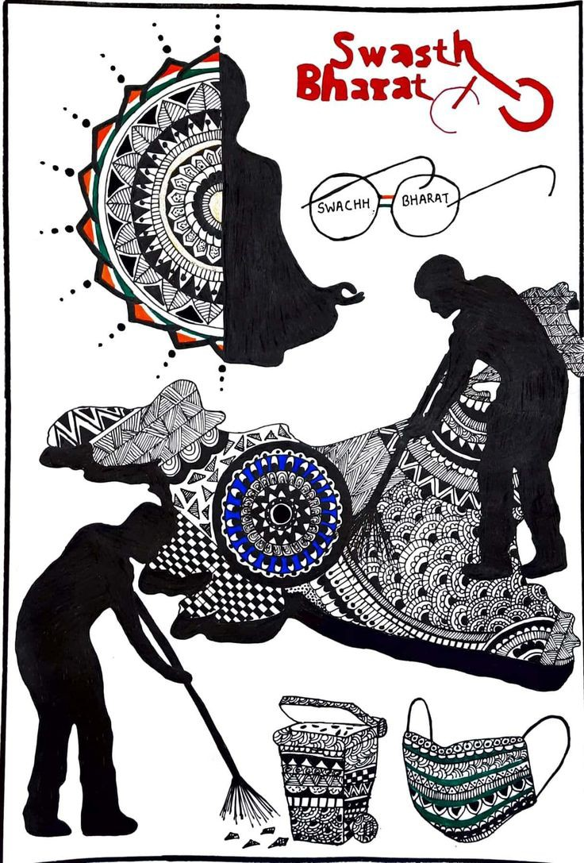
THANK YOU

